Slide 1
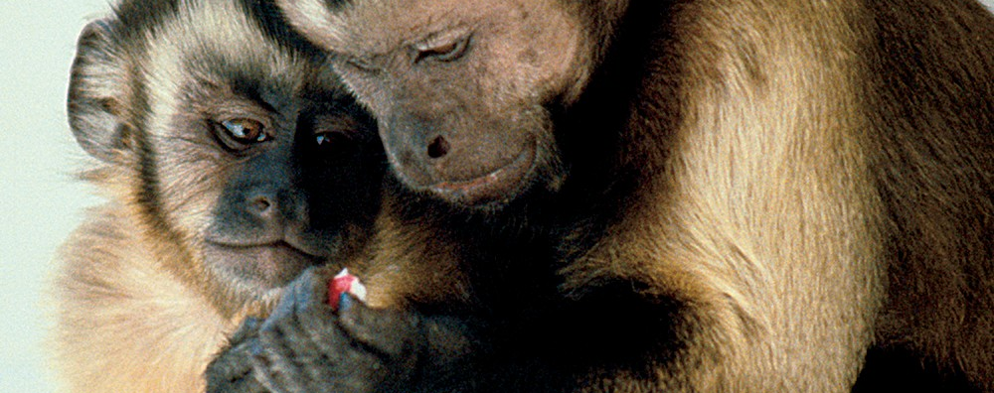
The Capuchin Text Classifier (CTC)
Mallikarjunarao Kosuri

Slide 2
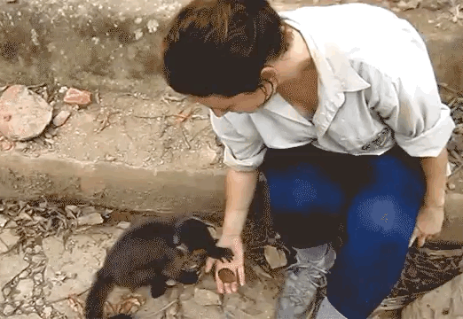
Capuchin Monkeys
Capuchin Monkeys are very intelligent animal, they teaches human how to use tools to survive.

Slide 3
Agenda
It’s all about
To-do, we need classifier
Market Pricing
Motivation factors
How does CTC works
Demo
Q&A
Will be a 10 min discussion?

Slide 4


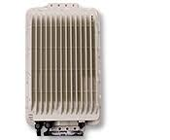

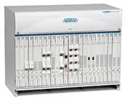
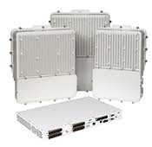
It’s all about
NLP
Voice

Slide 5
To-do, we need classifier …
Data
Train
Non Actionable Results
{‘text’: ’configure evc-map’, ‘intent’: ‘edit-config’}
Supervised classification
How to configure evc-map
{’intent’:’edit-config’}
NLP Q&A
{‘text’: ‘show me current evc-map table’, ‘intent’: ‘get-config’}

Slide 6
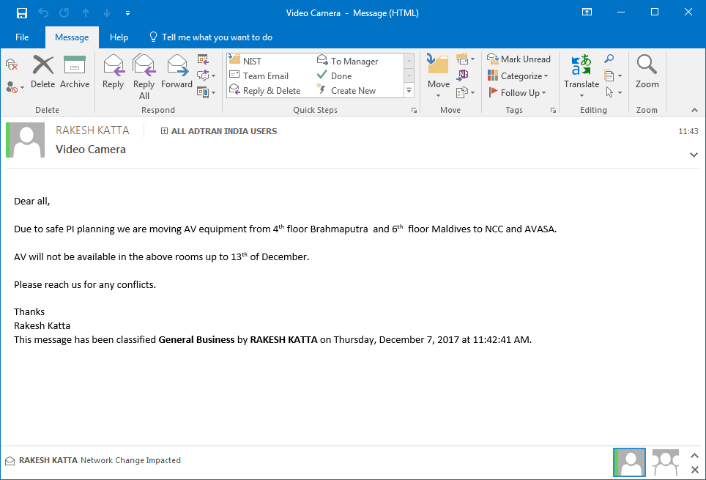
An example
I think we are classifying though sales force

Slide 7
Market Prices
Organisation | Per month (Approximately based on API) | Per year (Approximately based on API)
Google | Around $500 | $6000
IBM Watson | Around $500 | $6000
Monkey Learn | $299 | $2400
Salesforce | ?? | ??
Wolfram alpha | ?? | ??

Slide 8
Motivation factors
Data curation
Based on Intents
Based on Parts Of Speech
Data
Train
Supervised classification
Non Actionable Results
{‘text’: ’configure evc-map’, ‘intent’: ‘edit-config’}
How to configure evc-map
NLP Q&A
{‘text’: ‘show me current evc-map table’, ‘intent’: ‘get-config’}
{’intent’:’edit-config’}
Sequential Process
User has to process inputs
$

Slide 9
How does CTC works
Natural language generation from “X” models
Train
NLP
Actionable Results

Slide 10

Demo

Slide 11
Future work
Improving YANG parsing on data, data-filter, operation APIs
Use wide Varity of data generation sources, for e.g. SNMP, YANG, etc.
Task generation for testing text understanding and reasoning https://github.com/facebook/bAbI-tasks
Learning embeddings for classification, retrieval and ranking. https://github.com/facebookresearch/StarSpace
Dialog based language learning https://arxiv.org/pdf/1604.06045.pdf

Slide 12
Thank you. A&Z?

